Slide 1

Eileen, Jun Wei, Jonathan, Kai Jie, Wen Xiang
Notes:
Introduce solution name
Hi everyone and welcome to our presentation. today , we will cover our application that we have made for this year hackathon.
The name of our application is speed finance and we will be covering the problem that we have identified in the business sector, how our solution will help to solve this problem as well as how we come to build this solution.

Slide 2
Target Audience (TA)
Small and Medium-sized Enterprises (SMEs) and Bank Relationship Managers (RMs)
Problems faced by TA
Tedious and inefficient bank loaning process due to troublesome and messy loaning systems
Proposed Solution
Customer Relationship Management (CRM) system that is built using the Laravel framework and deployed on the cloud with the use of Amazon Web Services
Impact
Streamline loaning processes by developing a more efficient application to ease loaning processes for both SMEs and RMs
Notes:
Missing documents during application
Lack of follow ups from RMs
Tedious and long loaning process
Bank’s RMs have troublesome loaning systems - Unable to manage their leads efficiently

Slide 3
Solution
Leads tracking
Calendar view of leads
Visualisation of KPI and Leads
Automated Audit Logs
Notes:
Read off slides

Slide 4
Benefits
Better management
Increase profit margin
Increase customer reach
Timescale
700-TB dataset to S3 within two and half months using AWS DataSync
Notes:
Better management- able to track leads and keeps record of companies and application submission
Increase profit margin- by streamlining the process, applicants can apply for loan easier and more efficiently
Increase customer reach- every companies can create their own account and manages their loan application as it is easily accessible online
timescale - according to AWS storage blog, 700-TB dataset to S3 within two and half months using AWS DataSync. This is done swiftly with minimal effort and was completely self-managed with AWS DataSync.

Slide 5
COST
1 Classic Load Balancer
1 t2.micro EC2 instance
S3 Bucket that holds images
1 Route 53 Hosted Zone
Single EBS Environment
$25 (Load Balancer) + $7 (EC2 with an RI) + $0.70 (Route 53) + $0.24 (S3) + $0.30 (Data Transfer) = Roughly $33.24 a month.
Data transfer between AWS and internet – $0.09/GB
Data transfer with Amazon RDS within region
In – $0.01/GB
Out – $0.01/GB
Across region – $0.02/GB
Notes:
With all those benefit, lets talk about the cost. Monthly Cost of using AWS elastic beanstalk after calculation is $33.24
This calculation includes the cost for using Classic Load Balancer
1 t2.micro EC2 instance
S3 Bucket that holds images
1 Route 53 Hosted Zone
We also considered the cost of data transfer between AWS and internet AND within and across region
*read off from slides*

Slide 6
Risk
Amazon web services - Possible risk of downtime and data loss
Mitigation plan: To adopt using AWS Elastic Disaster Recovery (AWS DRS) to minimise the risk
Low adoption rate - Team might struggle to move over to the proposed new system
Mitigation plan: To provide training and to make sure system is aligned with the user needs
Notes:
We have identified 2 risks that we may encounter during the implementation. One is technological risk and the other is human factor.
*read off slides*
2. Human factor as we are resistant to change
*continue to read off slides*

Slide 7
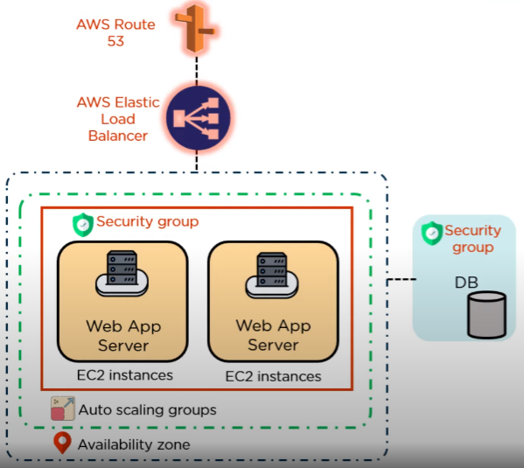
Architecture of AWS Elastic Beanstalk
AWS Route 53
Set up private and secured DNS
AWS Elastic load balancing (ELB)
Minimise the risk of the system crashing due to heavy traffic
AWS EC2 instance
AWS RDS
Uses mySQL
Flexible in changing storage size
Automated backups
AWS S3
Storing of audit logs
Encrypt data
Notes:
We will be incorporating AWS in our solution to scale and deploy our web application
AWS route 53 primarily used for DNS mapping will send our request to AWS load balancing. These requests will then be send to ec2 instances and will be embedded in a security grp.
These instances may change based on traffic (either up or down) and this is when our load balancer will be utilised to distribute the load.
AWS RDS and S3 will also be utilised in the AWS Elastic Beanstalk to store our data.
What we like about this Beanstalk solution is that it is dynamic in scaling and is able to scale up or down which helps to promotes cost efficiency

Slide 8
Technology Used
Laravel Framework
Open Source technologies
Data visualization:
Chart.js for data representation in bar charts & pie charts
FullCalendar.js for render interactive calendar view
jQuery DataTables for easy searching, sorting and pagination of table listings
SweetAlert2 for beautiful, responsive popup boxes
Cloud computing:
Amazon Elastic Beanstalk
Programming languages:
PHP
SQL
JQuery
Notes:
For framework, we use Laravel
As for the technology, we use some open sources to improve on our application
For data visualization, *read off slide*
For cloud computing, we use Amazon elastic beanstalk.
As for the programming languages that we used, they are *read off slides*

Slide 9
Application Process
If approved, application status changes from “pending” to “approved”
Submission of all relevant documents for business loan application by users
Manager submit for approval or abort applications. If aborted, application status changes to “aborted”
Senior Manager reviews “pending” applications
Application status changes from “new” to “reviewing”
START
Step 1
Step 2
Step 3
Step 4
Step 5
Step 6
Step 7
Step 8
END
Data entry, application submission by RMs
Managers to review all submitted applications with “reviewing” status
Application status changes from “reviewing” to “pending”
Senior Manager either approves or rejects the application.
If rejected, status will change to “rejected”
Notes:
All relevant documents for the loan application will be submitted by SMEs
RMs collates all the documents submitted and submits a new loan application into the system
During this process, the application status changes from new to reviewing
All new applications submitted by RMs then are reviewed by Managers to be approved or aborted
If aborted, app status changes from reviewing to aborted
Otherwise, app status will change frm reviewing to pending
All approved applications will then go through further review by senior managers
SMs makes the final decision of rejecting an application after going through further reviews, app status changes from pending to rejected
Otherwise, if approved app status changes frm pending to approved and a loan application is successfully granted

Slide 10

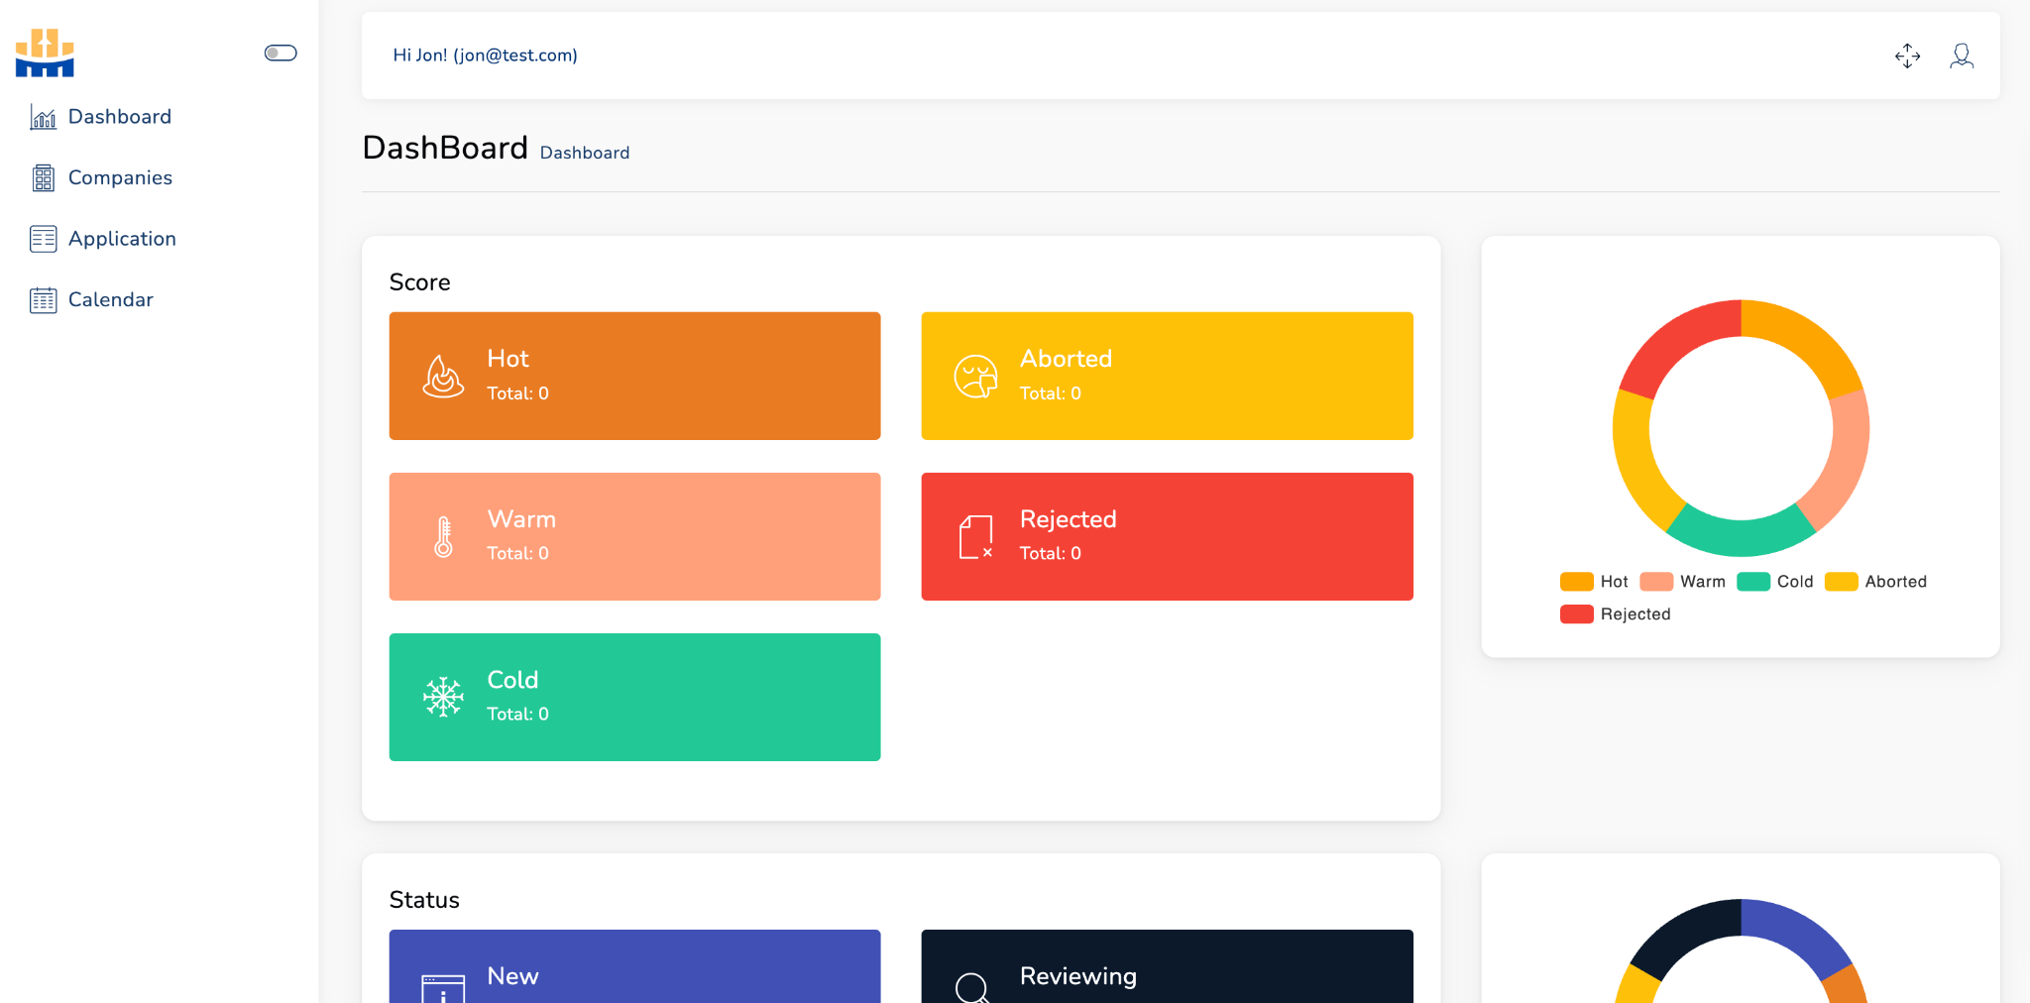
Demonstration of solution
Notes:
???

